Slide 1
LaunchTone™
A Digital Instrument Using the TI LaunchPad Microcontroller
Zach Martin
Spring 2025 Final Project
Professor Shahnam Mirzaei
ECE595R - Robotics & Embedded Systems

Slide 2
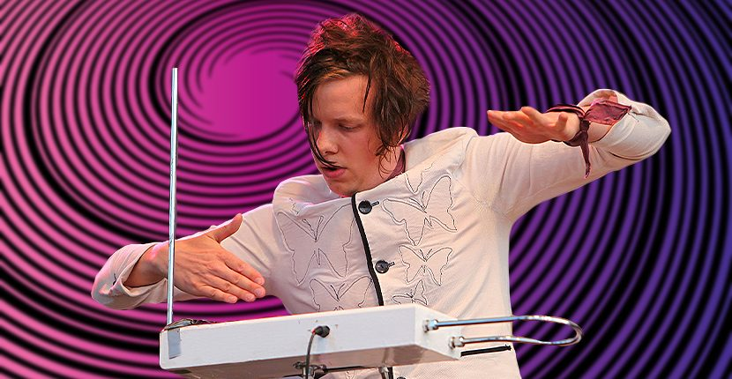
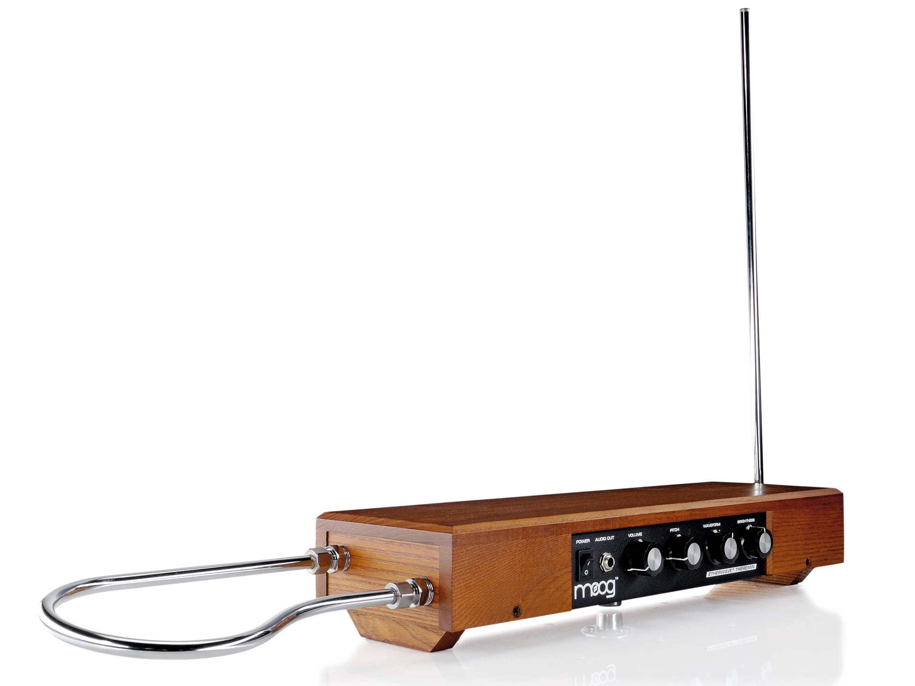
Project Overview
Contactless musical instrument
Played by blocking sensors at varying distances
Status LEDs and LCD Display
Multiple sound profiles
Moog Etherwave Theremin [1]
Swedish musician Detektivbyrån rocking a theremin [2]

Slide 3
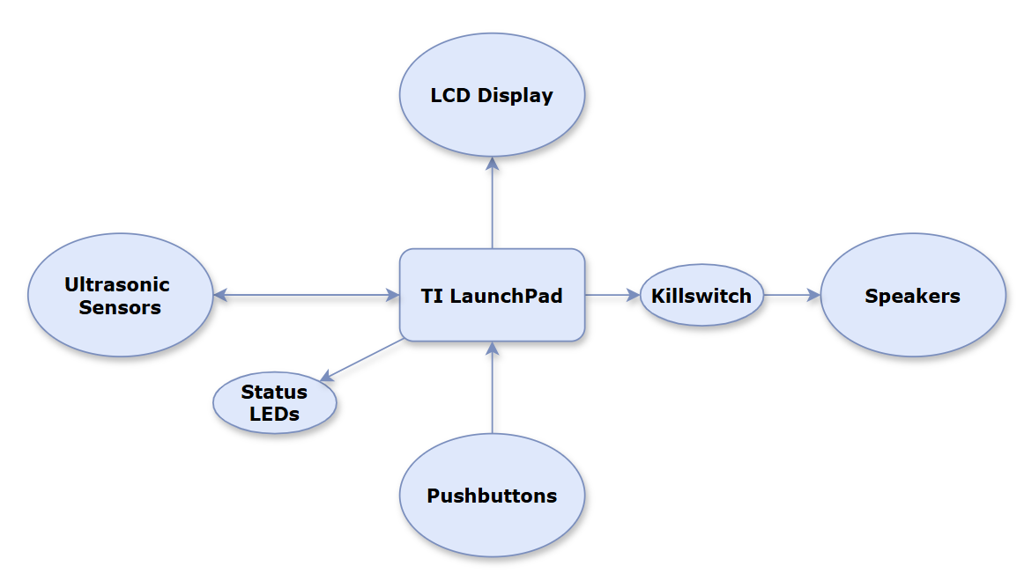
Block Diagram
Planned Design

Slide 4
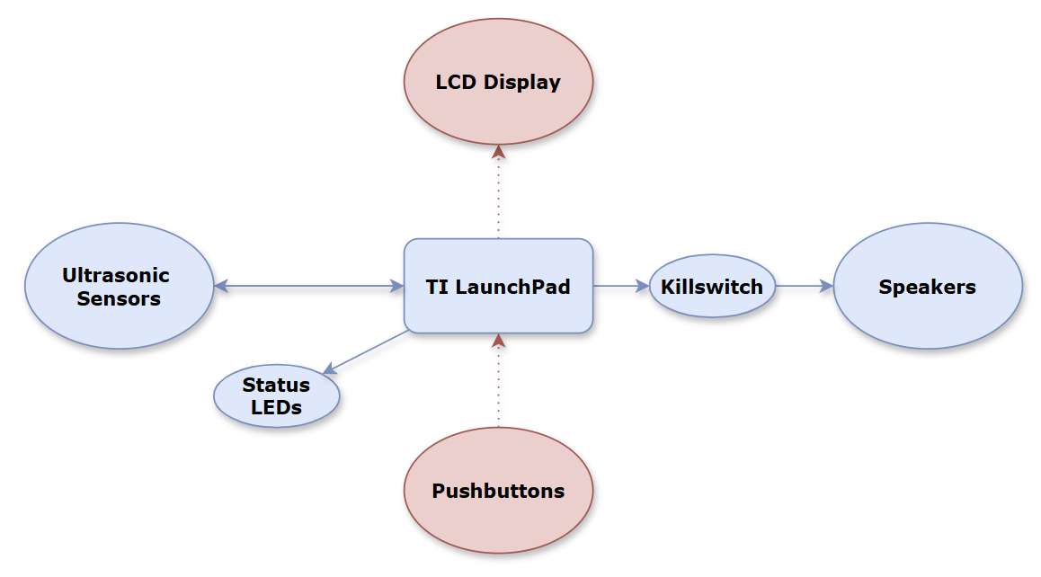
Block Diagram
Current Design
Block Diagram
Current Design

Slide 5
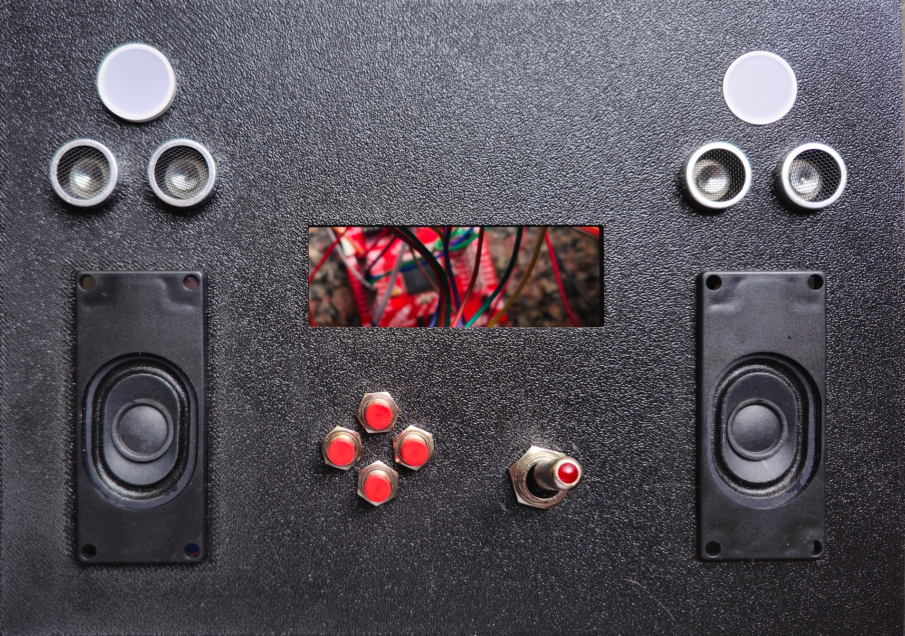
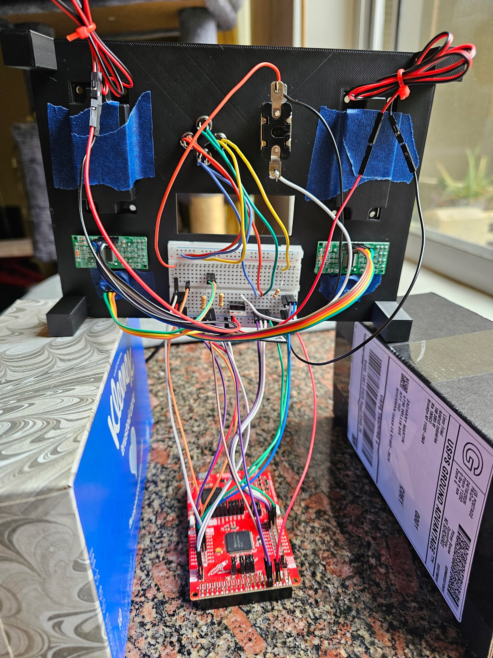
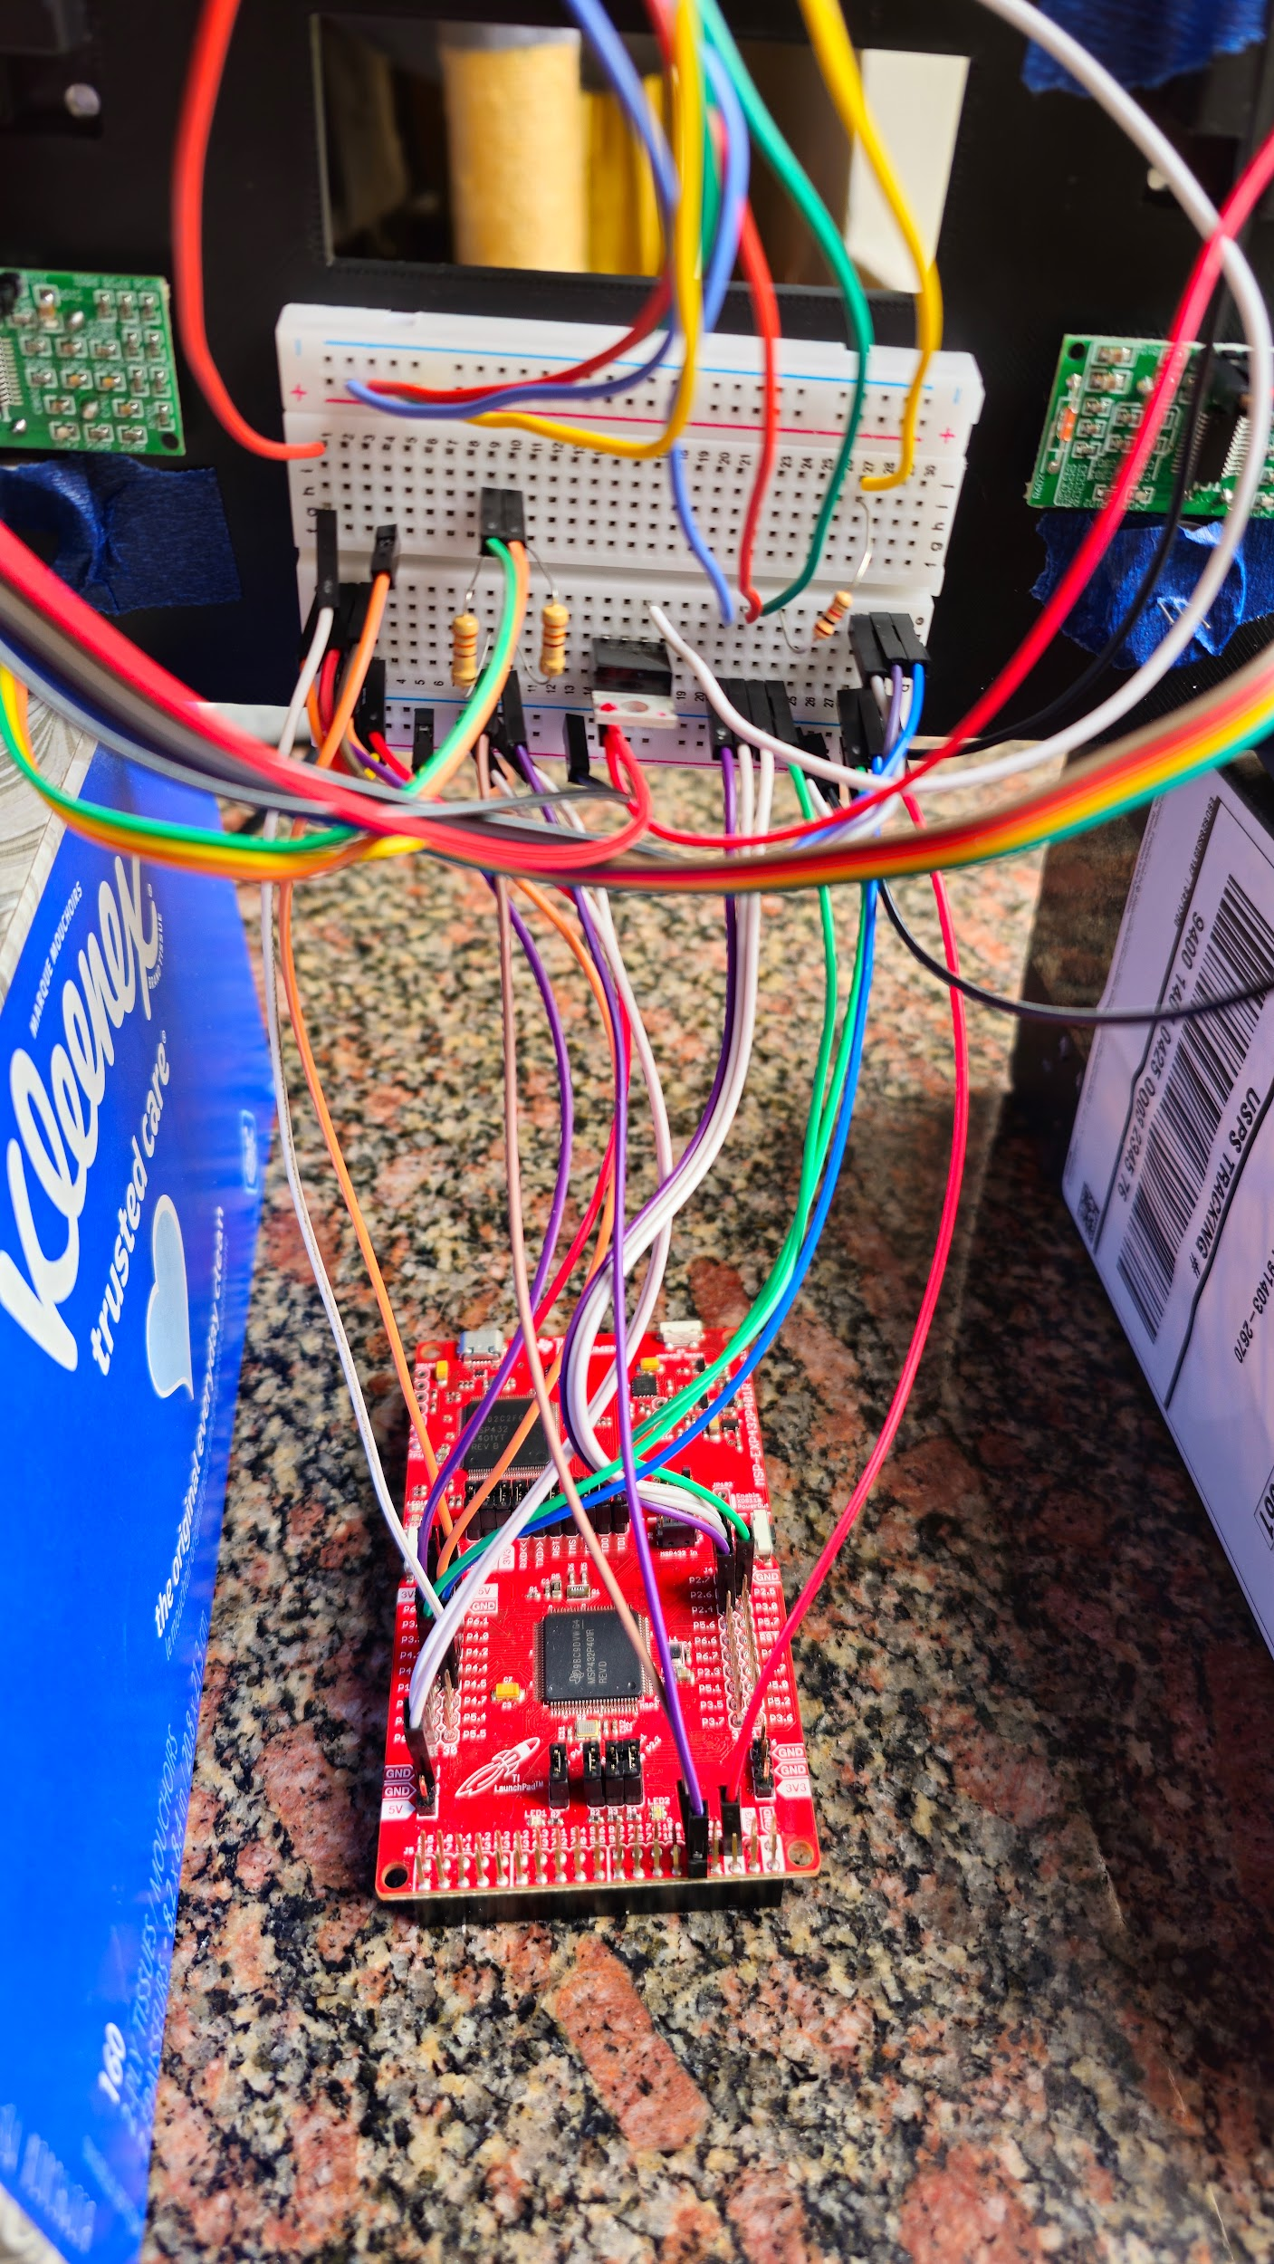
Current Implementation
Front Surface
Underside
Underside - Close

Slide 6
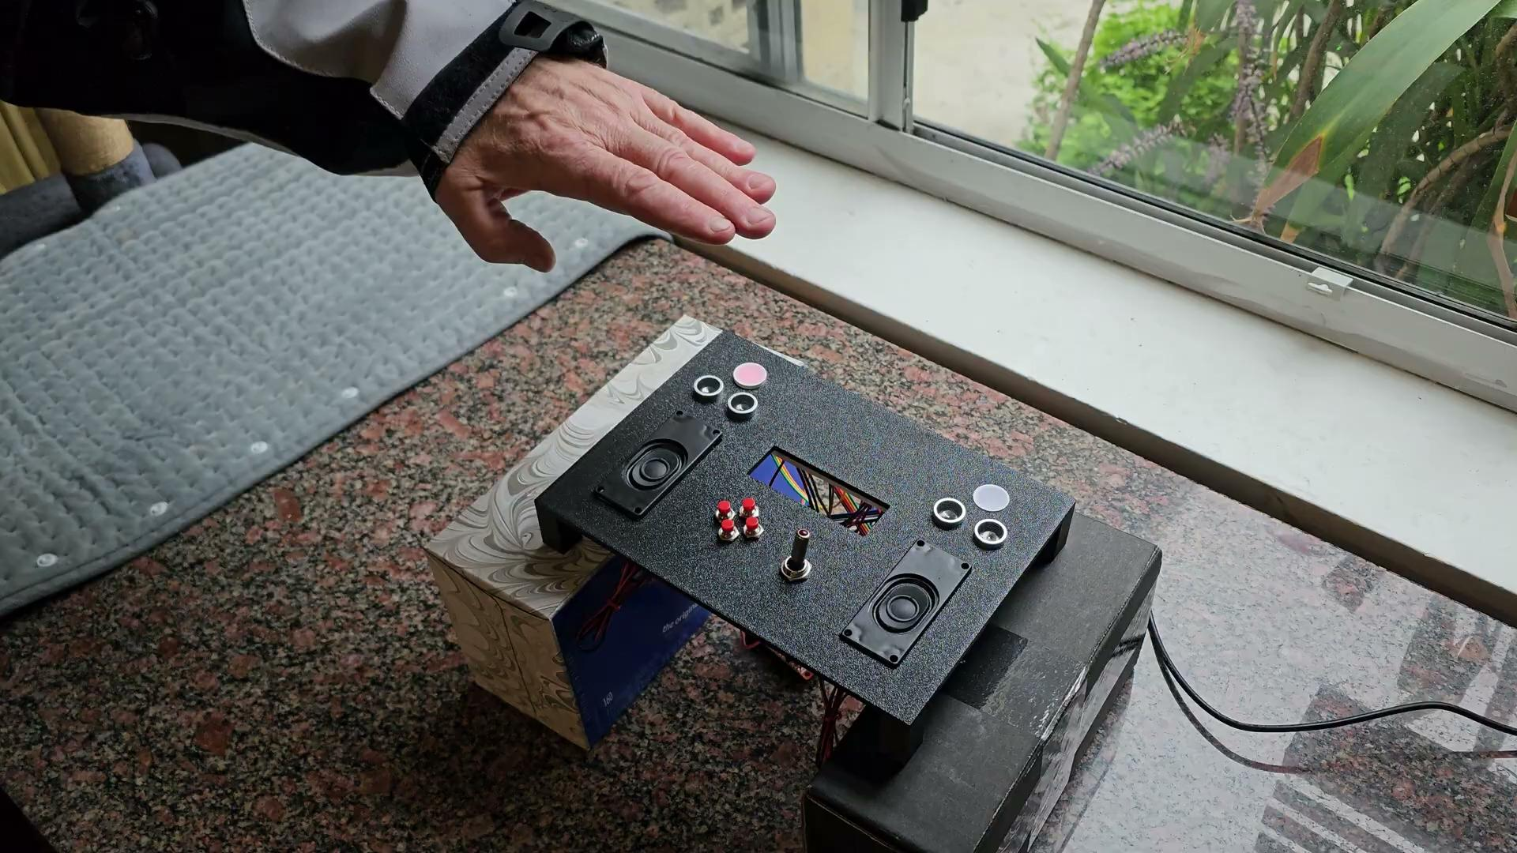
Video Demonstration

Slide 7
Wiring
Component | Component Pin | LaunchPad Pin
Ultrasonic Sensor 1 | TRIG | P4.0
 | ECHO | P4.1
 | VDD | +5V
 | GND | GND
 | GND2 | GND
Ultrasonic Sensor 2 | TRIG | P4.2
 | ECHO | P4.3
 | VDD | +5V
 | GND | GND
 | GND2 | GND
Killswitch | VDD | P4.5
 | GND | GND
 | TRAVELER | SPEAKER RED**
Speakers | RED | TRAVELER**
 | BLK | GND
Component | Component Pin | LaunchPad Pin
Red-Green LED 1 | 1 | P10.0
 | 2 | GND
 | 3 | P10.1
Red-Green LED 2 | GND | P10.2
 | GND2 | GND
 | TRIG | P10.3
Pushbutton 1 | 1 | P2.4
 | 2 | +5V
Pushbutton 2 | 1 | P2.5
 | 2 | +5V
Pushbutton 3 | 1 | P2.6
 | 2 | +5V
Pushbutton 4 | 1 | P2.7
 | 2 | +5V

Slide 8
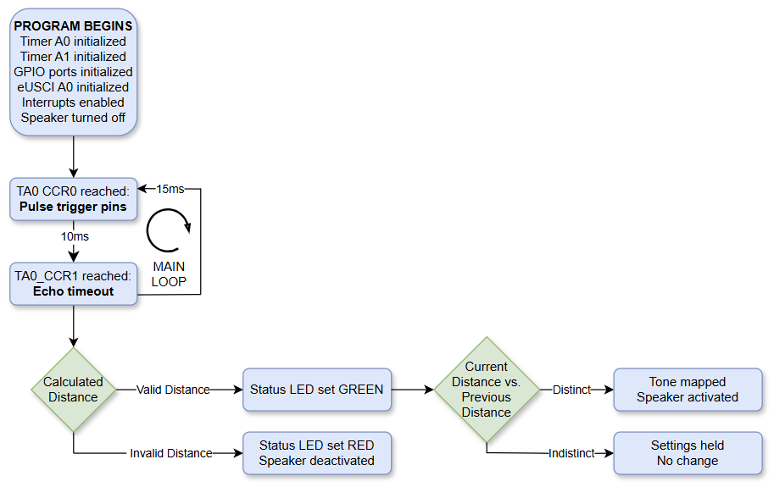
Program Flow Chart…
Detektivbyrån still rocking

Slide 9
Code Overview
Imported Files
msp.c
Library for interfacing MCU
Source: Texas Instruments
CortexM.c
Enables systemwide interrupts
Source: Jonathan Valvano
Clock.c
Provides delay functions and initializes system clock
Source: Jonathan Valvano
EUSCI_A0_UART.c
Directs print statements to the serial console
Source: Aaron Nanas
Handwritten Files
Timer_A0.c
Coordinates ultrasonic trigger and echo signals
Timer_A1.c
Creates square wave signals for speakers
GPIO.c
Configures peripheral connections to sensors, LEDs, speakers, buttons, and killswitch
Drives status LEDs
Ultrasonic_Sensor.c
Triggers ultrasonic sensor and processes data
Speaker.c
Activates and deactivates speakers, plays tones

Slide 10
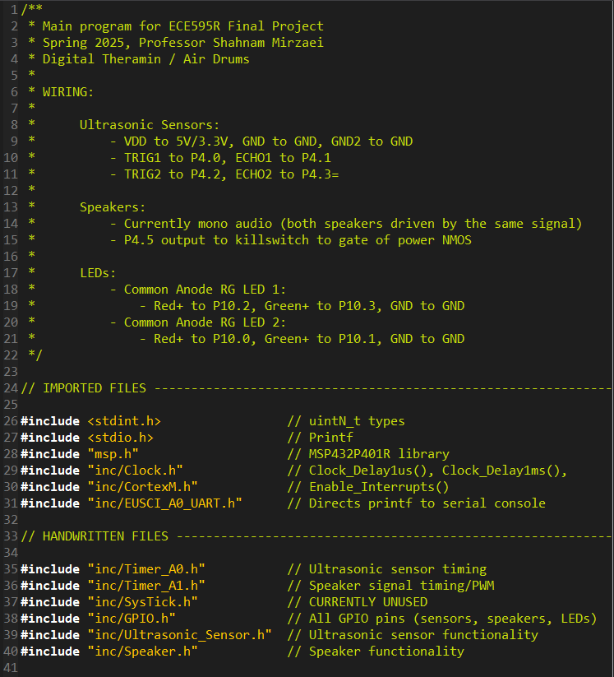
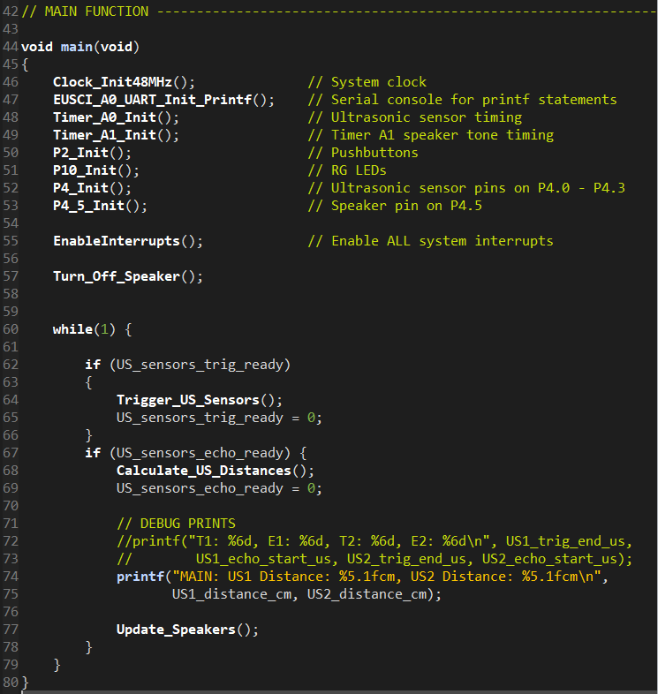
main.c

Slide 11
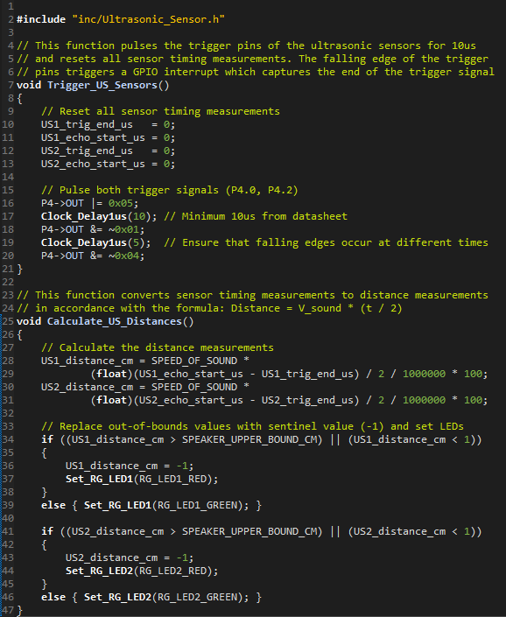
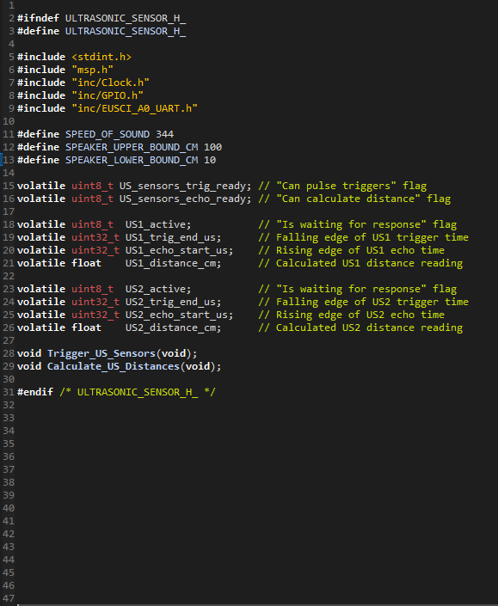
Ultrasonic_Sensor.c Ultrasonic_Sensor.h

Slide 12
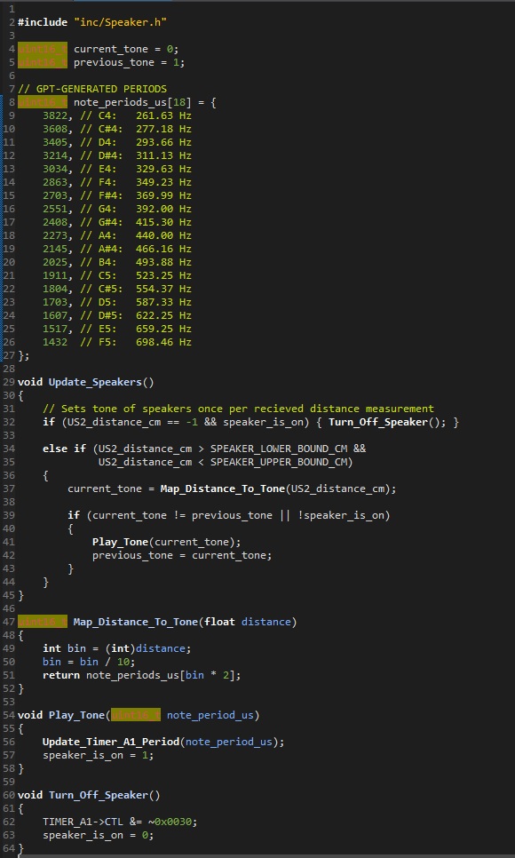
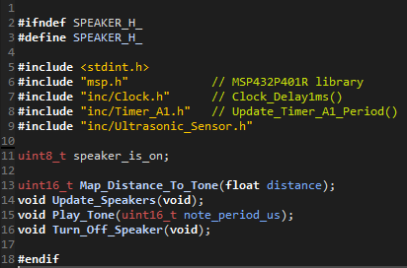
Speaker.c Speaker.h

Slide 13
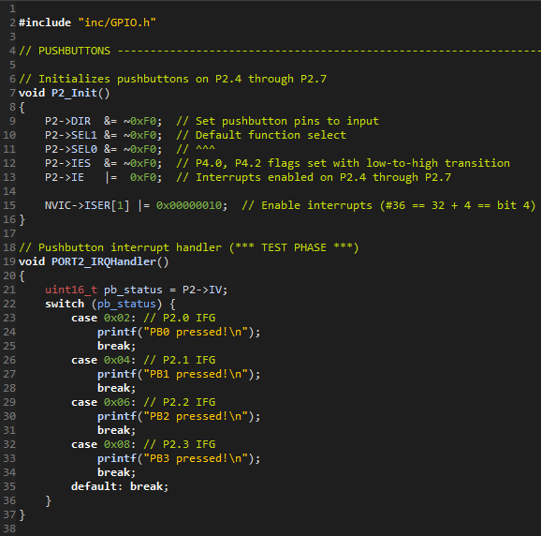
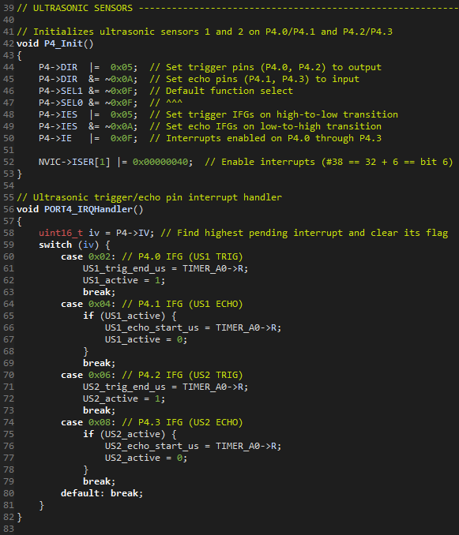
GPIO.c

Slide 14
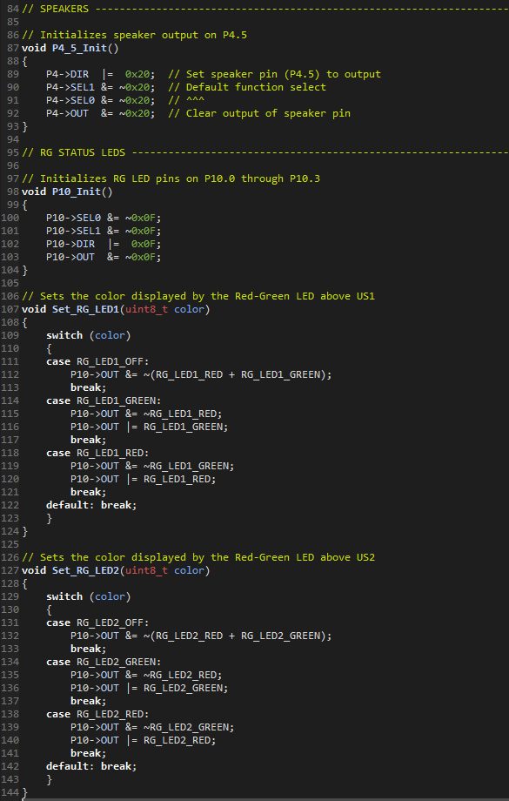
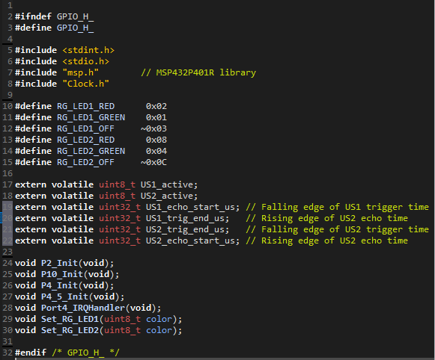
GPIO.c (continued) GPIO.h

Slide 15
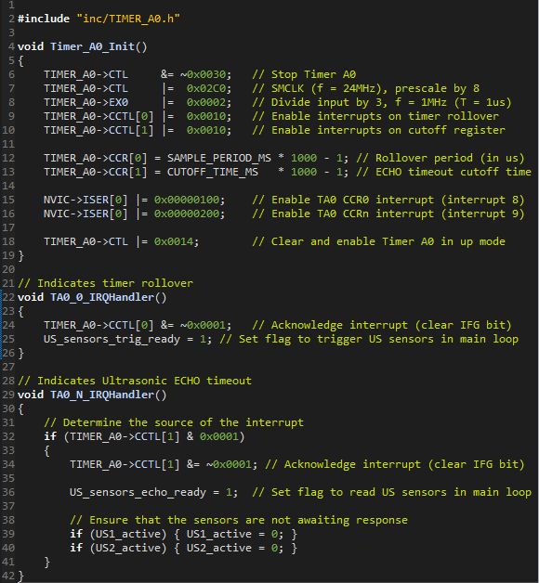
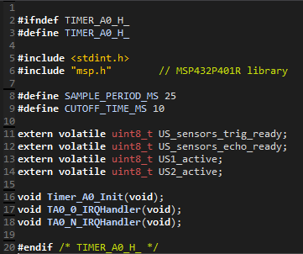
Timer_A0.c Timer_A0.h

Slide 16
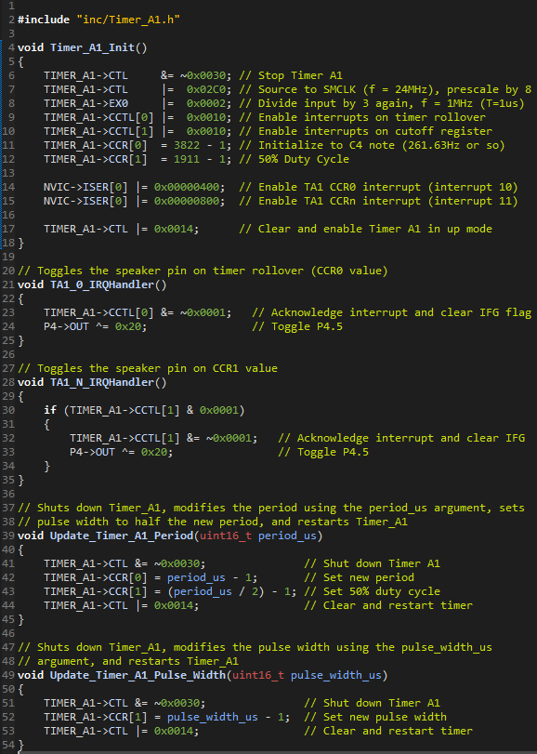
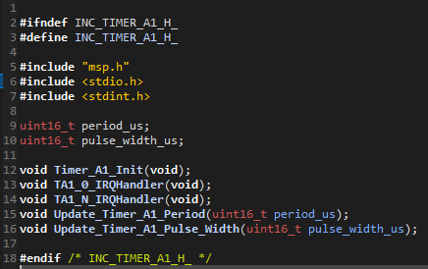
Timer_A1.c Timer_A1.h

Slide 17
Further Development
Original Design
Install LCD Display
Code Pushbuttons (Mode Select, Pitch Modulation, etc.)
Replace Faulty Ultrasonic Sensor
Additional Features
Explore Alternative Sound Profiles (Air Drums, Piano, Guitar, etc.)
Smooth Transitions Using Filter Algorithm
Tighten Ultrasonic Beams
Construct Enclosure

Slide 18
References
“Moog Etherwave Theremin review,” Musicradar. https://www.musicradar.com/reviews/tech/moog-etherwave-theremin-179236.
“The Eerie Sounds of the Theremin – Music of the Future that Arrived 100 Years Ago,” Thevintagenews. https://www.thevintagenews.com/2019/09/25/theremin/.
Texas Instruments, “MSP432P4xx Technical Reference Manual,” Archive. Available: web.archive.org/web/20200402132841/http:/www.ti.com/lit/ug/slau356i/slau356i.pdf.
draw.io, “Flowchart Maker & Online Diagram Software”. https://app.diagrams.net/.

